Slide 1
React Native
Keyboard Input, State, Timer

Slide 2

BMI Calculator App

Slide 3
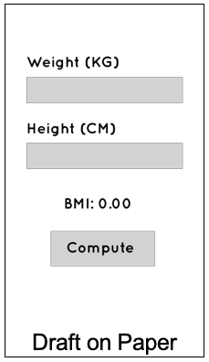
Making BMI Calculator App
Create container that fill whole screen
Set the flexDirection of container to ‘column’ and its justifyContent: ‘center’
Start Adding Elements
Text
TextInput
TouchableOpacity

Slide 4
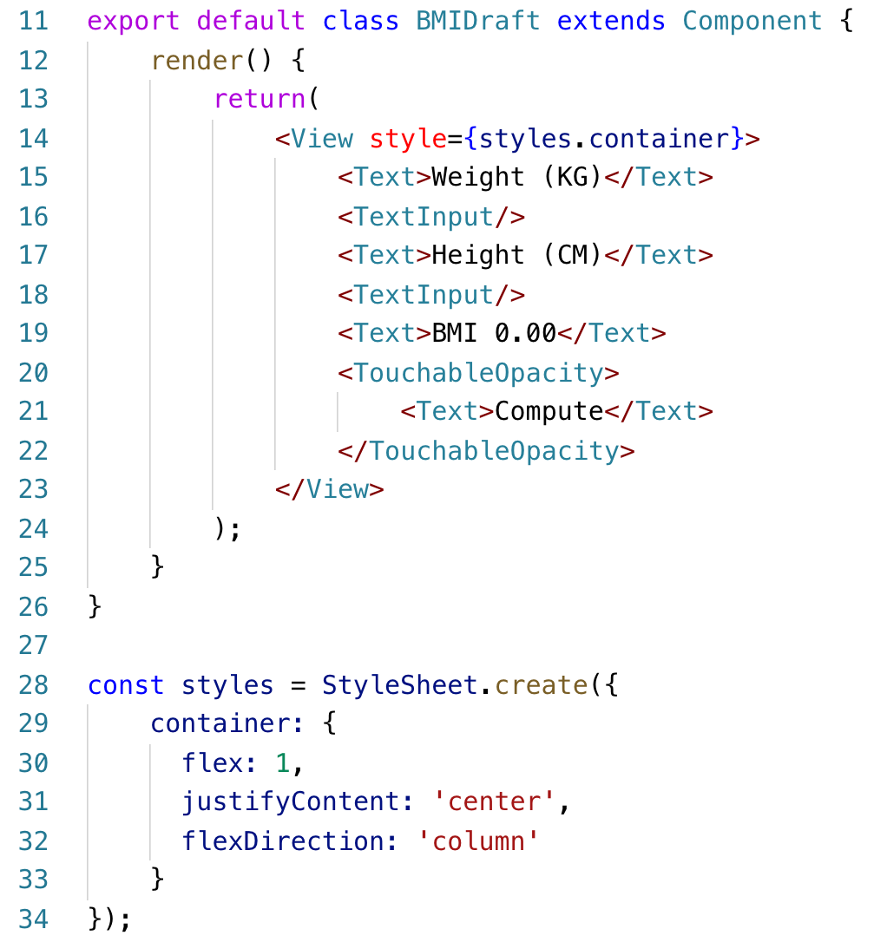
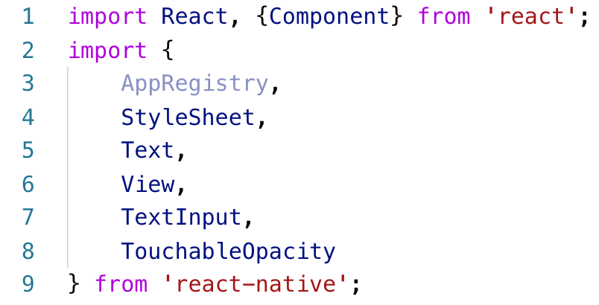
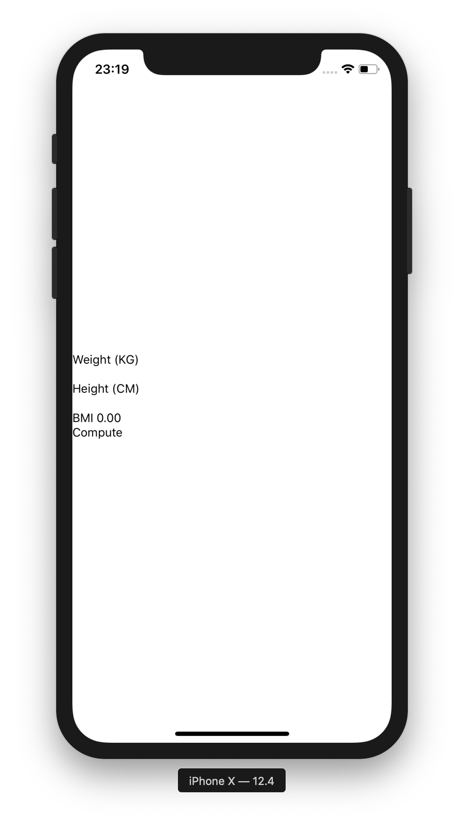
Making BMI Calculator App

Slide 5
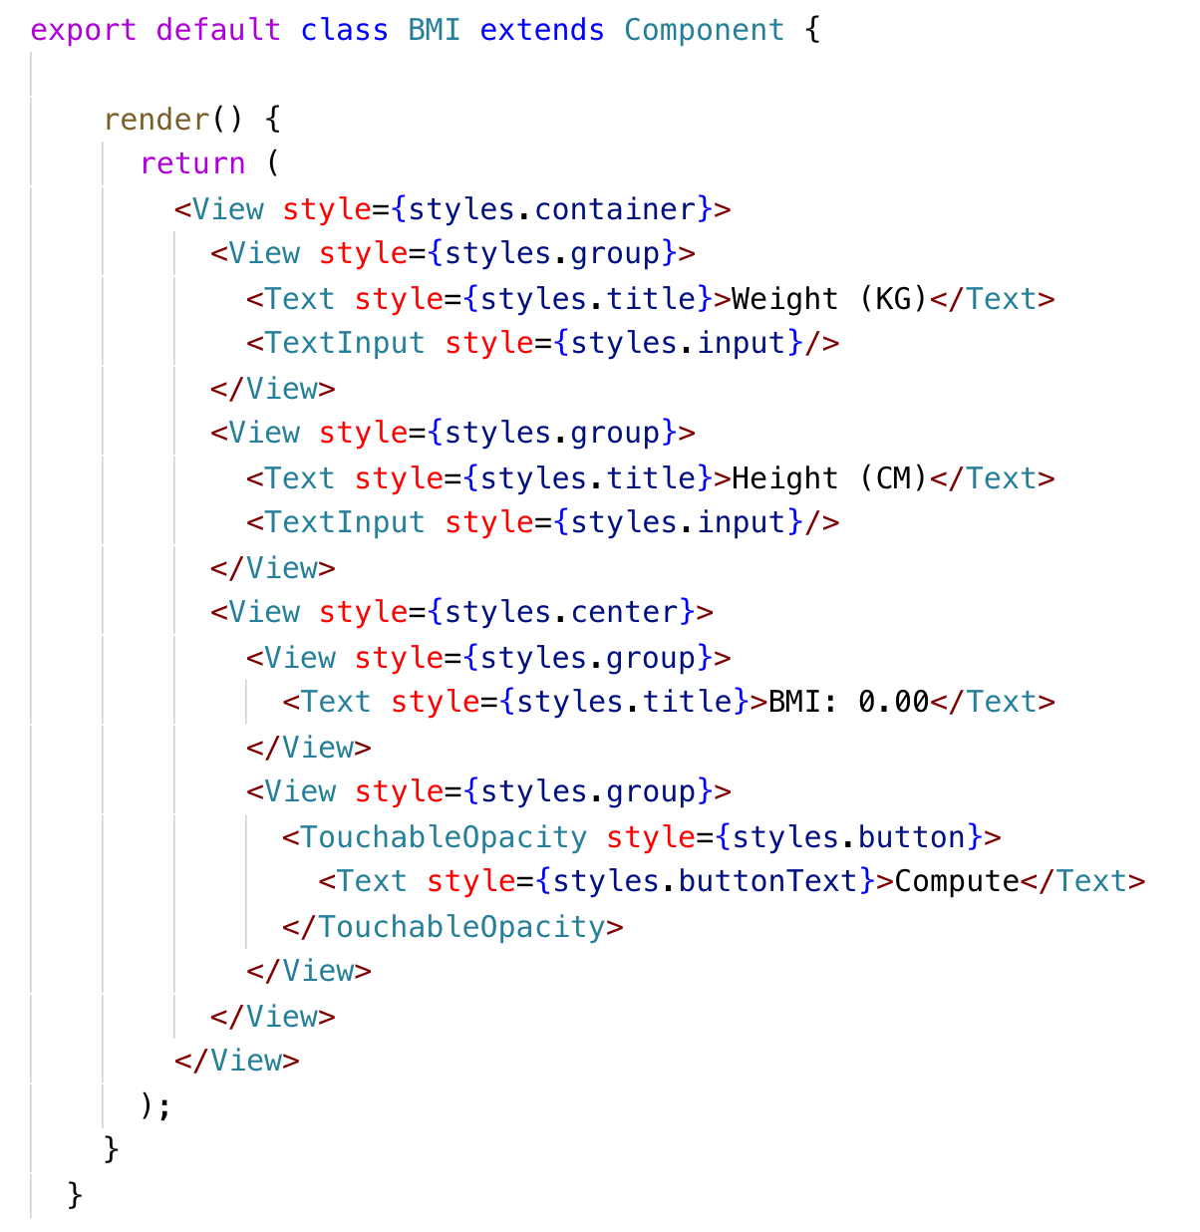
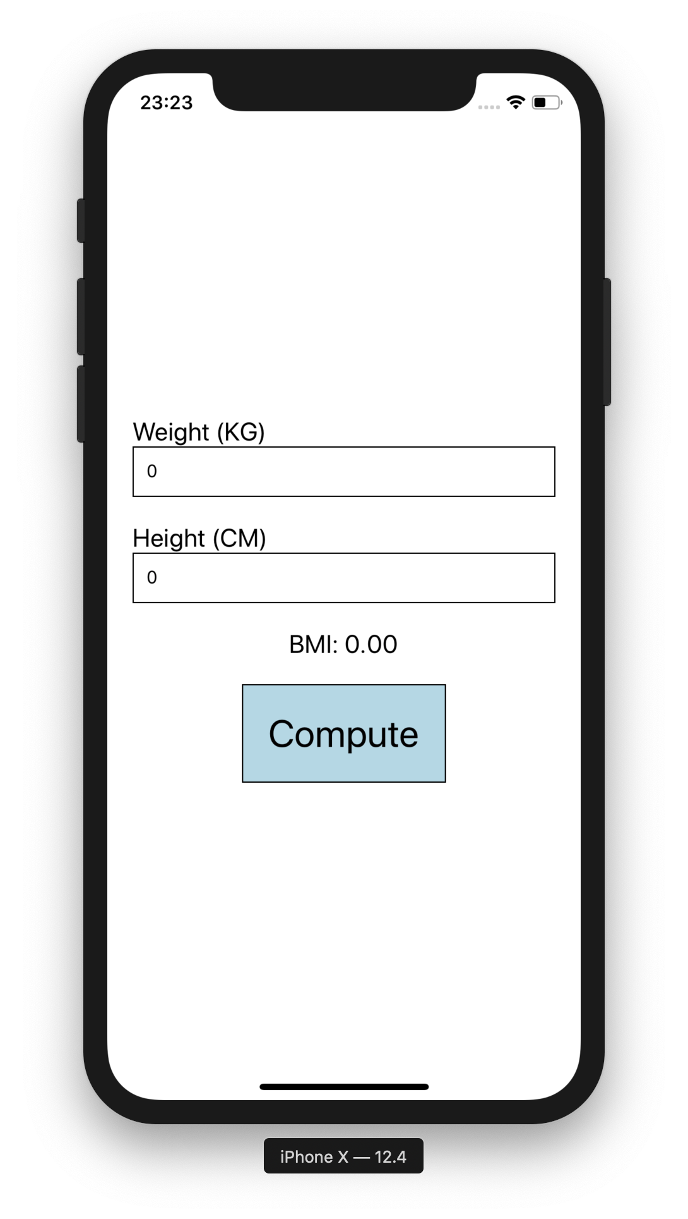
Making BMI Calculator App
Using view to group each items

Slide 6
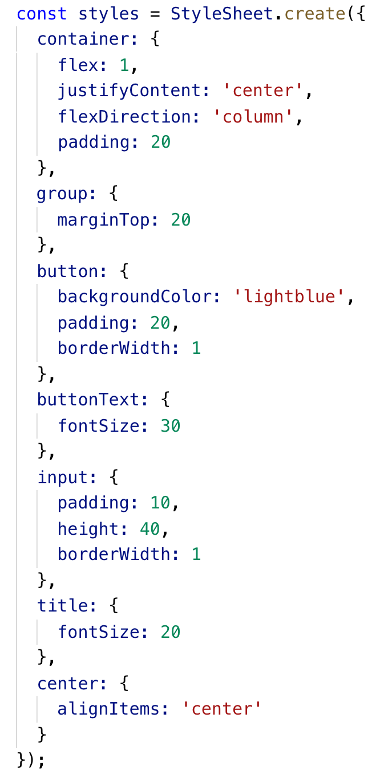
Making BMI Calculator App

Slide 7
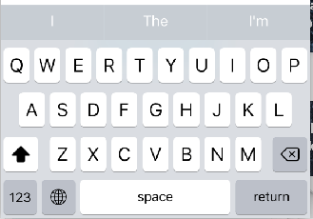
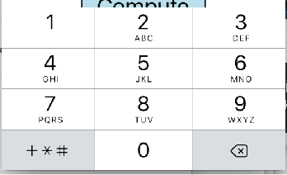
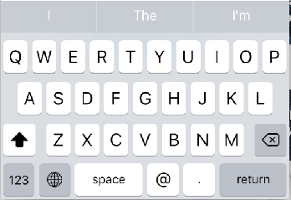
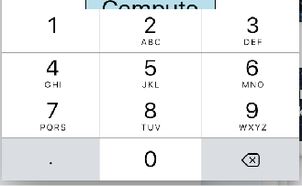
Keyboard Types (Cross-Platform)
<TextInput keyboardType=‘default’>
default
iOS (9.3)
phone-pad
numberic
email-address

Slide 8
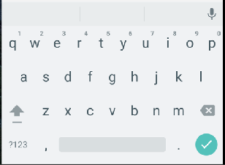
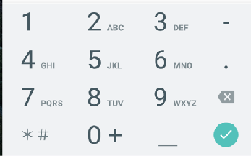
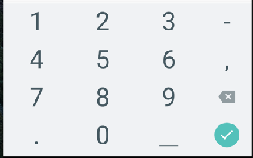
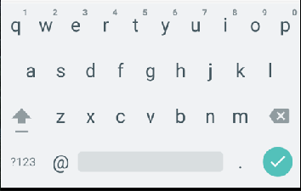
Keyboard Types (Cross-Platform)
<TextInput keyboardType=‘default’>
Android (9.3)
phone-pad
numberic
email-address

Slide 9
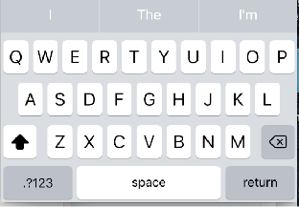
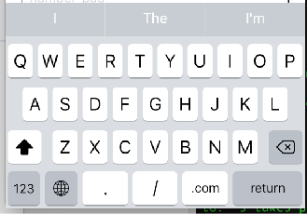
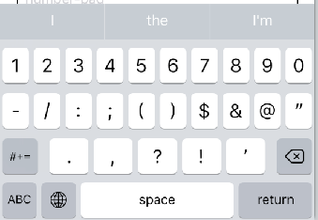
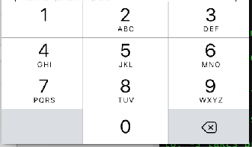
More Keyboard Types (iOS Only)
<TextInput keyboardType=‘default’>
ascii-capable
url
numbers-punctuation
number-pad

Slide 10
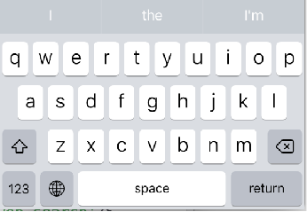
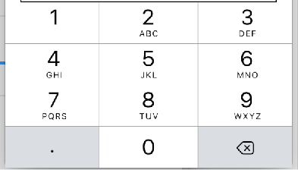
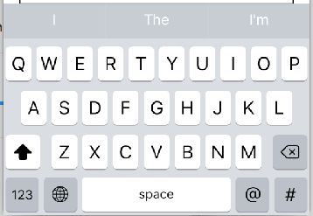
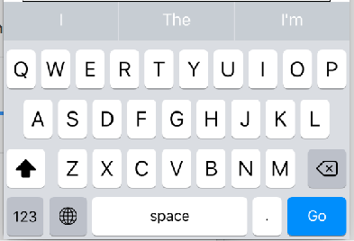
More Keyboard Types (iOS Only)
<TextInput keyboardType=‘default’>
name-phone-pad
decimal-pad
twitter
web-search

Slide 11
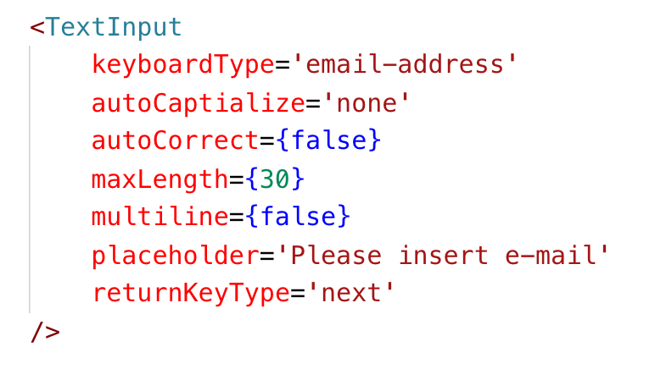
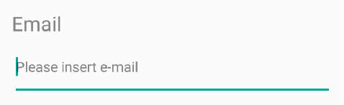
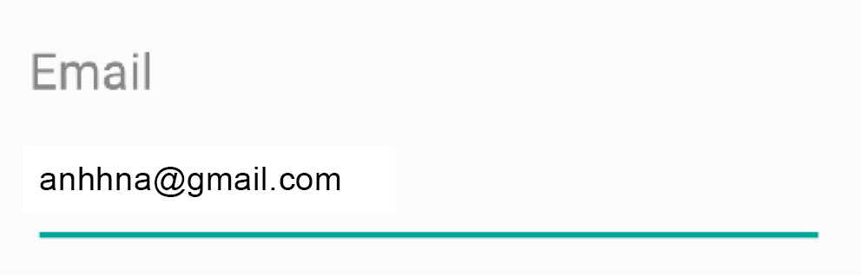
More TextInput Attribute
https://facebook.github.io/react-native/docs/textinput.html

Slide 12
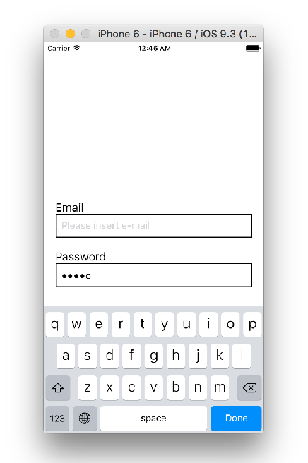
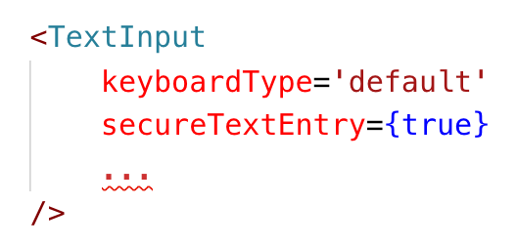
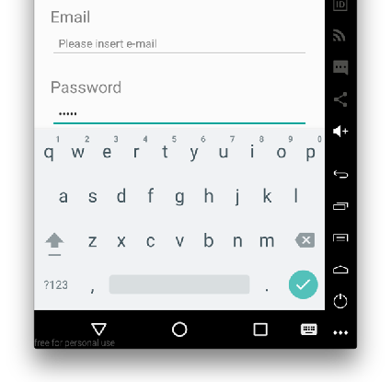
Password TextInput

Slide 13
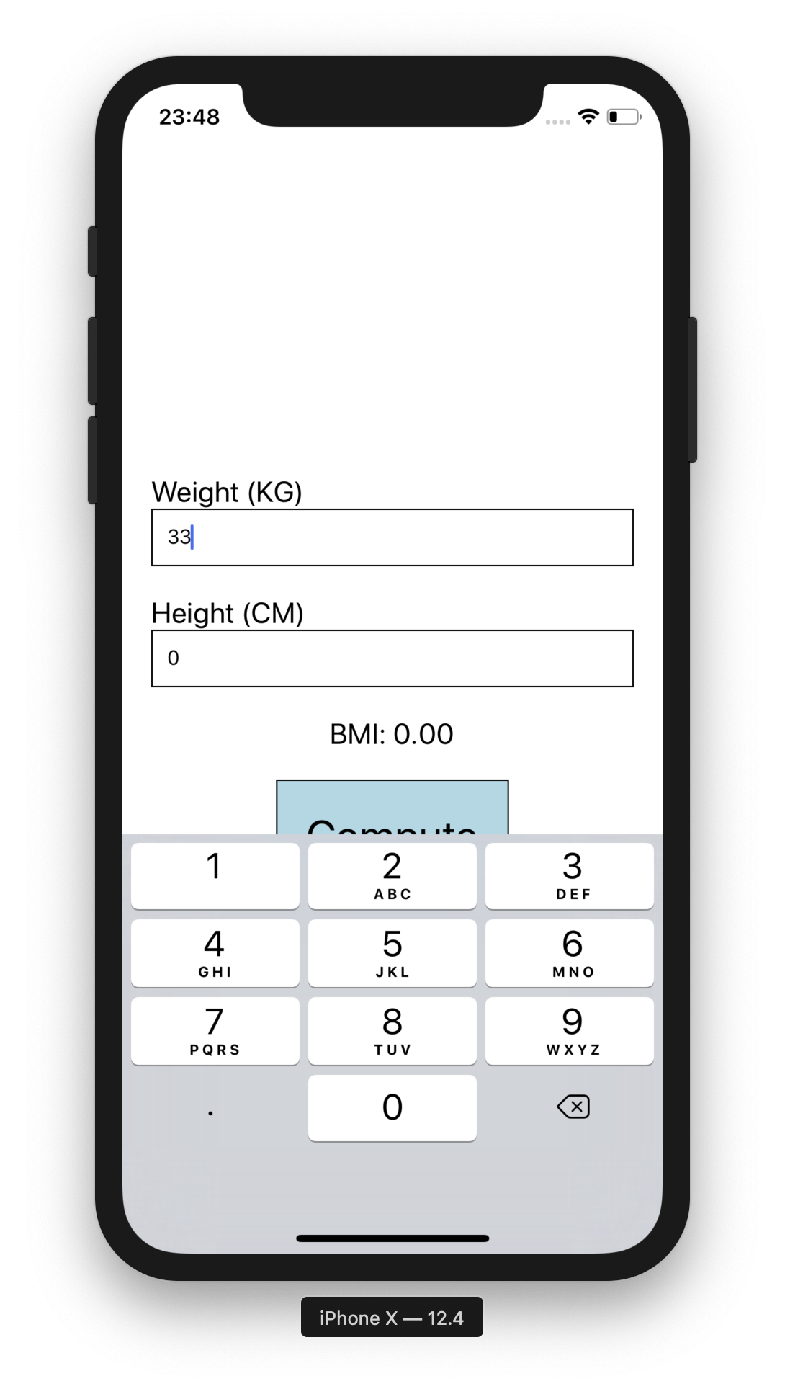
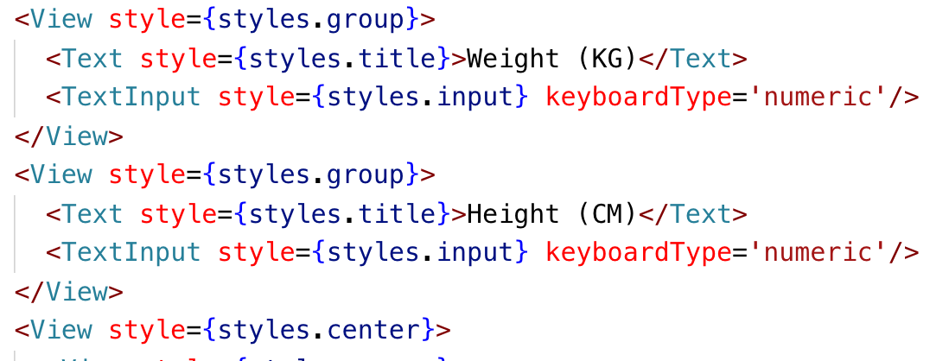
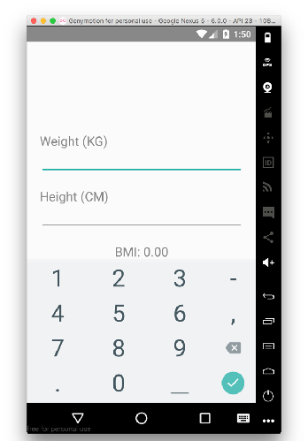
KeyboardType
iOS -> Cmd-K to Open/Hide Keyboard

Slide 14
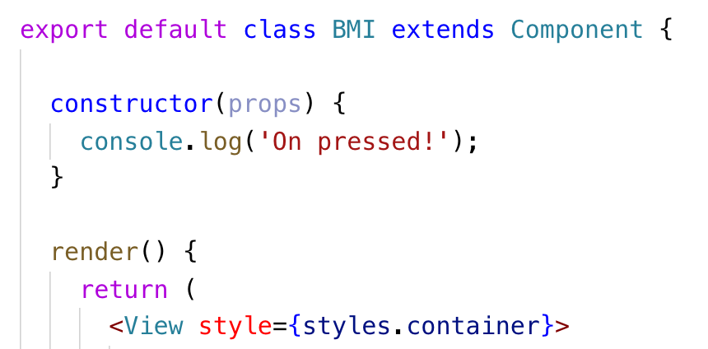
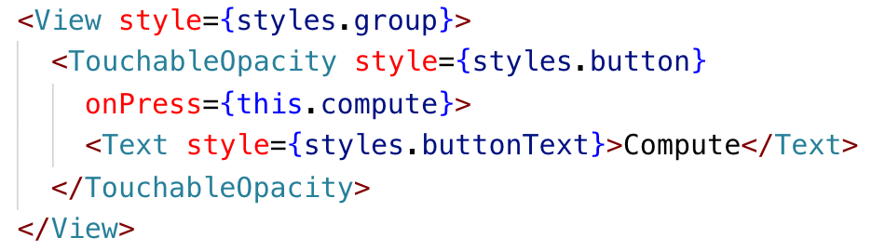
Add User Input Feedback

Slide 15
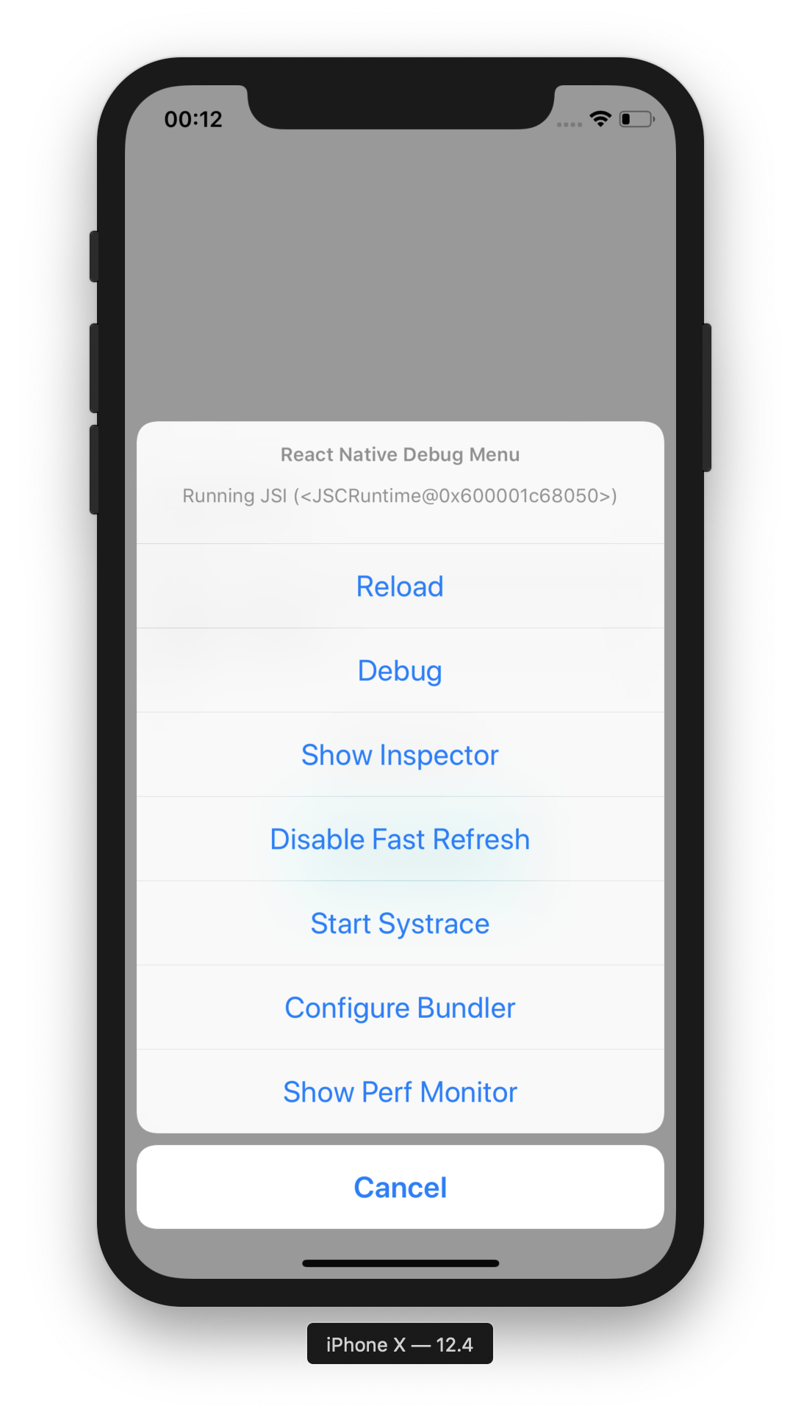
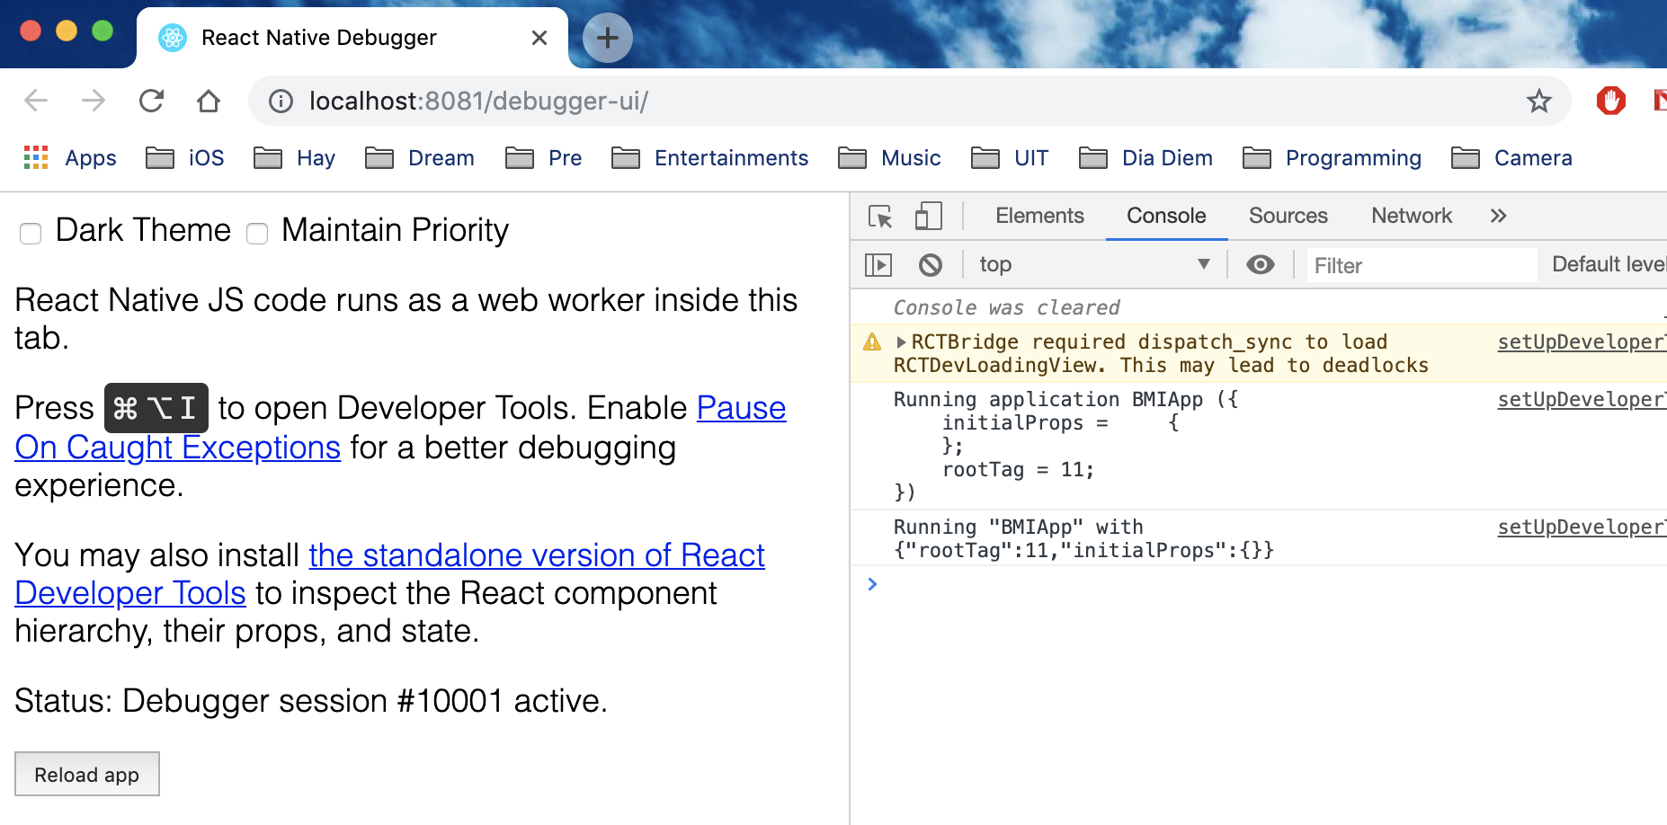
Enable JS Debugger
Cmd - D (iOS)
Menu Button (Android)

Slide 16
State
State is a JavaScript Object that we use to track and response to users’ inputs
Each React component has its own instance of state
Most important thing about state:
Any change in state will cause all components or any children components inside of it to be re- rendered

Slide 17
State’s Rule of Thumb
When using state in component, always set the initialize state to the reasonable values
Always use
this.setState(changedObjects)instead of this.state.changedObject = someValue
If not using this.setState(), React something will not acknowledge the changes. Components will not be re-rendered
Some strange behavior will happen in the app

Slide 18
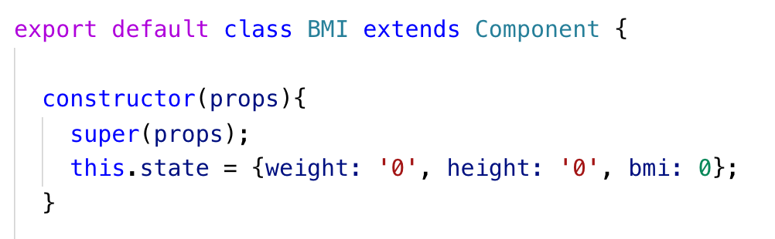
Initialize State
We first defined 3 variables in state at the class’s constructor
weight (String) = ‘0’ - It is a string because we use it with TextInput
height (String) = ‘0’ - It is a string because we use it with TextInput
and calculated bmi (Number) = 0

Slide 19
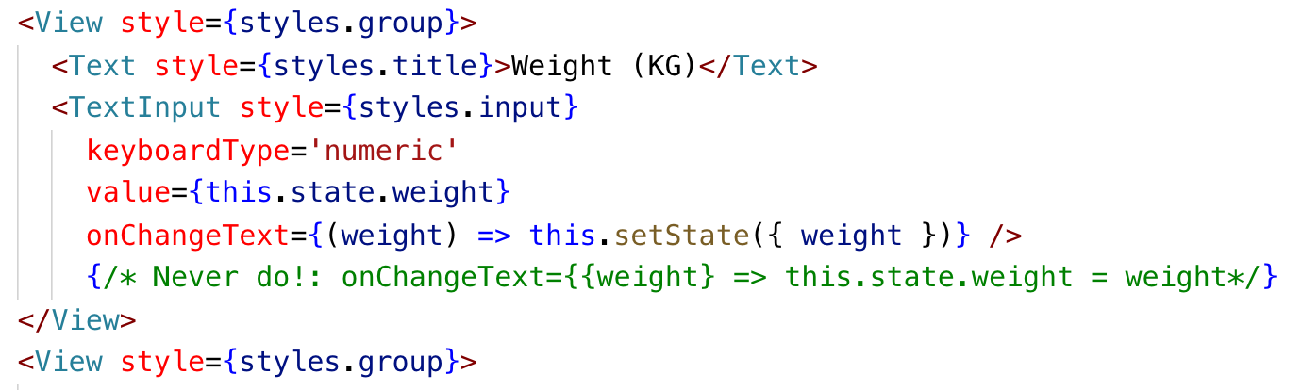
Showing/Setting State In TextInput
value attribute - setting the text according to the state.weight’s value
onChangeText attribute - invoked when user making change the TextInput, apply the new input value into the state

Slide 20
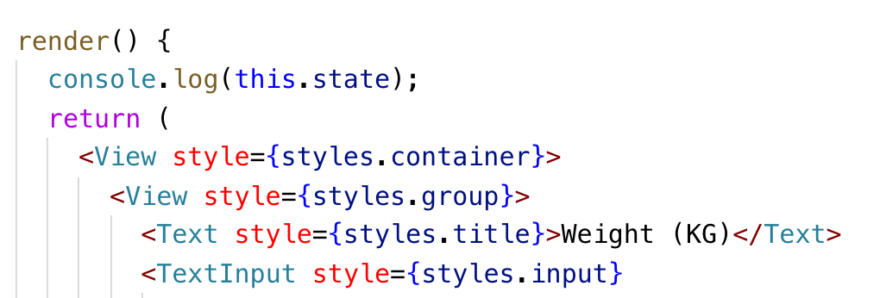
See State In Action
To see state working in action, print the state value in render()
Run the application
Typing some number into Weight (KG) and then Typing some number into Height (CM) and see the difference

Slide 21
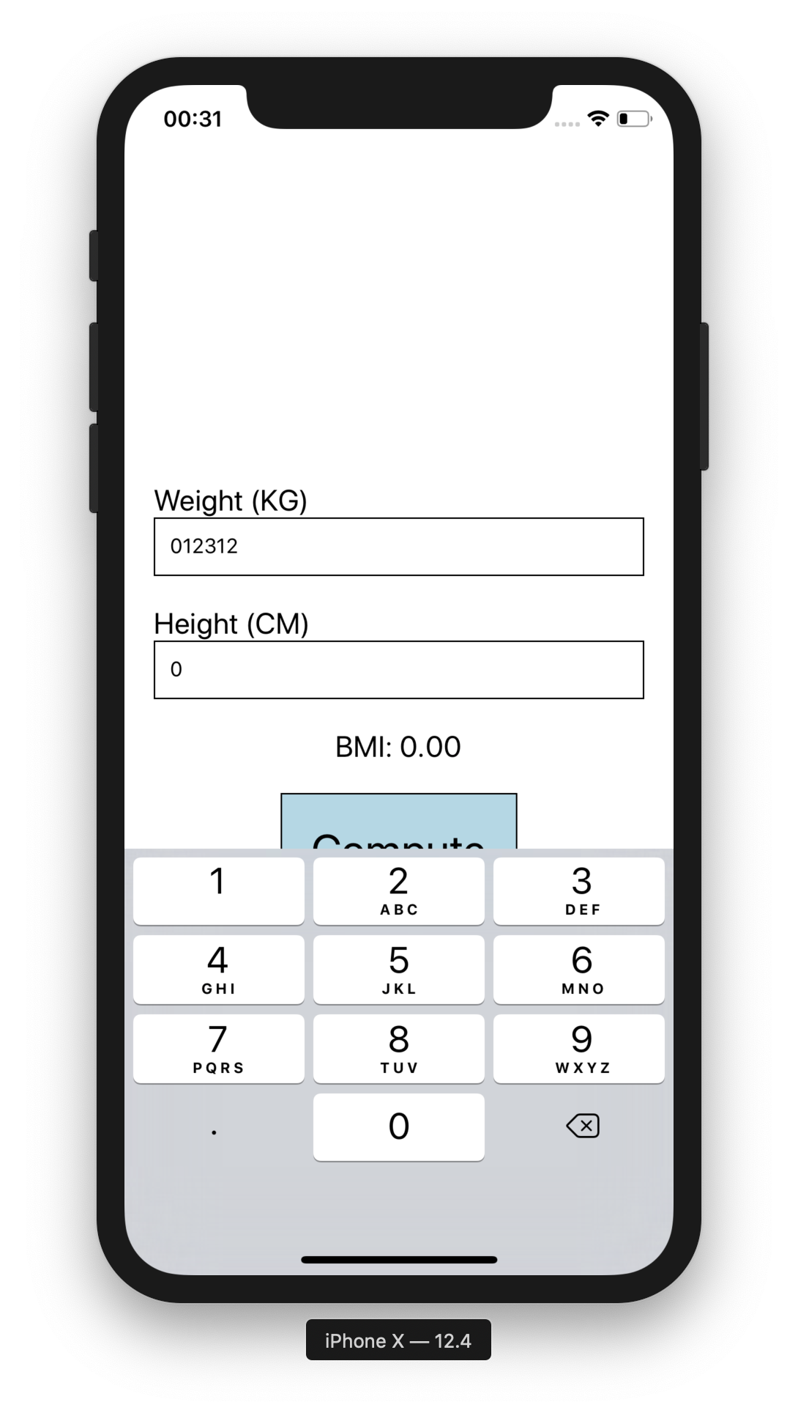
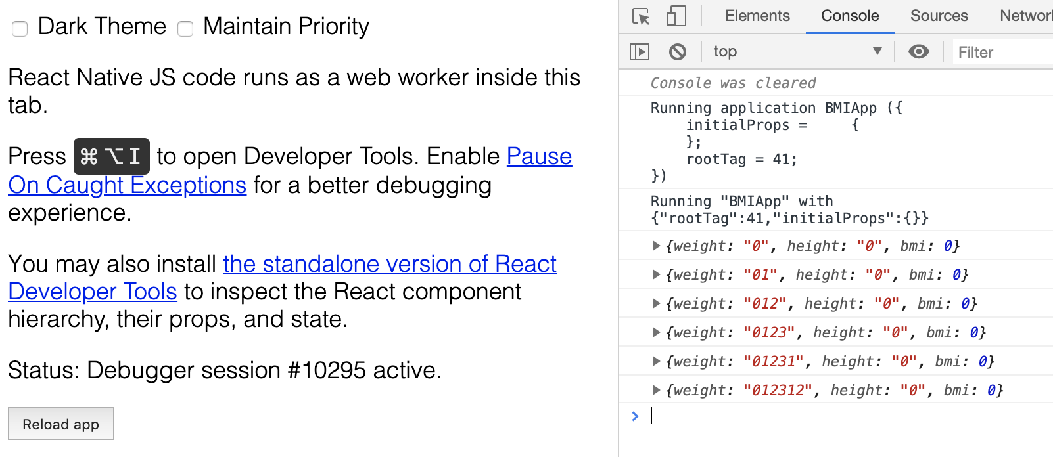
See State In Action
Console in React Native Debugger will print the state’s content, only when the text in Weight(KG) is changed, because the state make the component re-render.

Slide 22
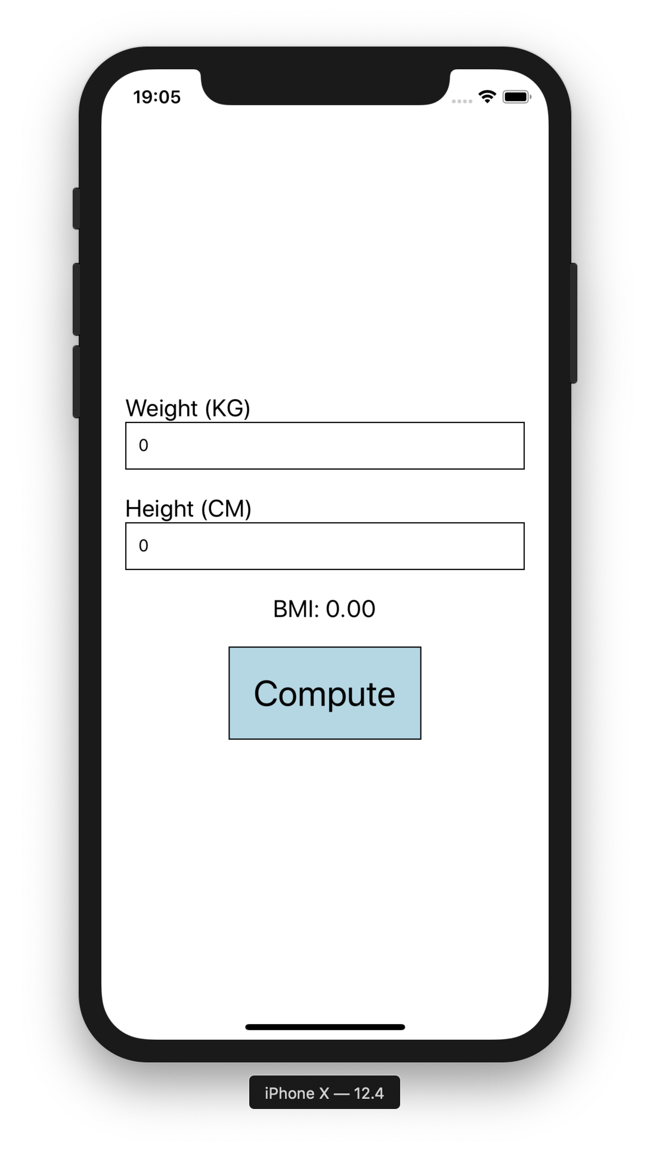
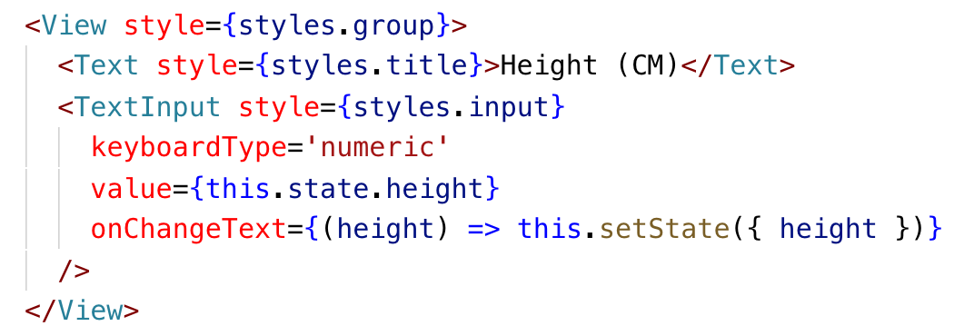
Continue On Height TextInput

Slide 23
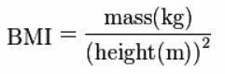
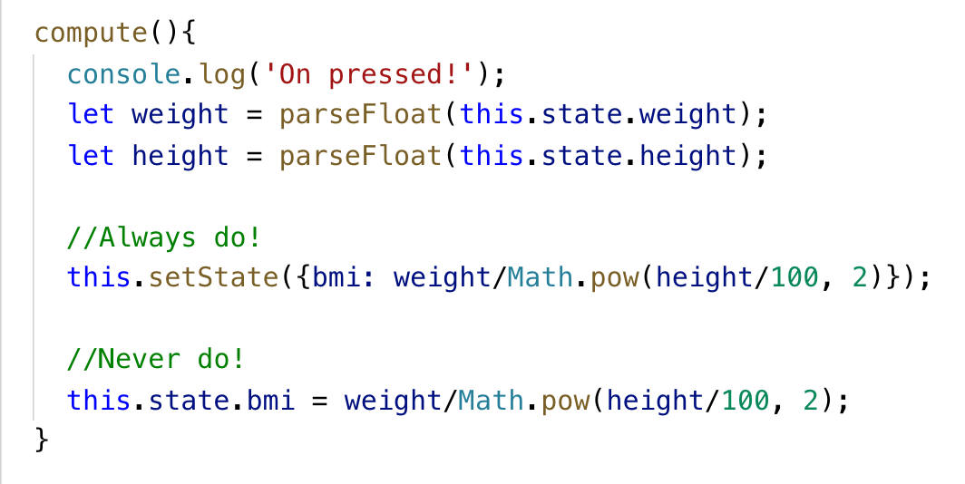
Let’s Compute The BMI

Slide 24
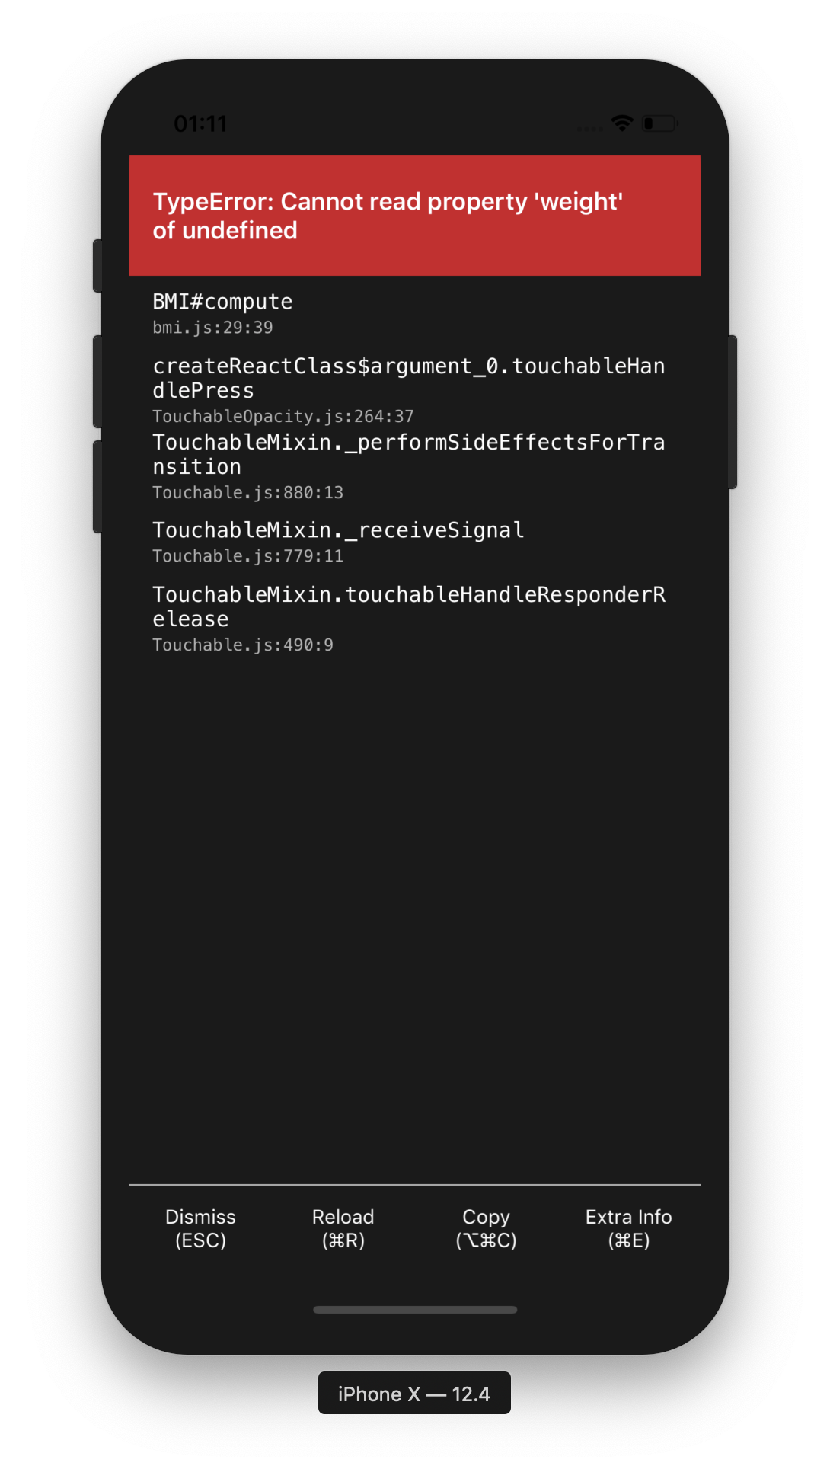
Method Biding
Refresh the app now, input some number, and push compute button. You will see the red screen.
It is because compute() method is not the standard method in the component class (We added it by our own)
The scope of compute() method is not yet visible to the class’s state.

Slide 25
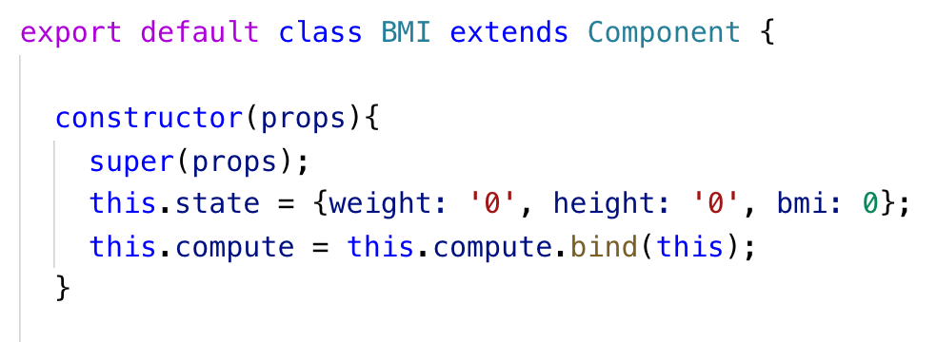
Method Biding (cont)
You can bind the scope, by using bind() statement
The best place to bind the method is at the class constructor.

Slide 26
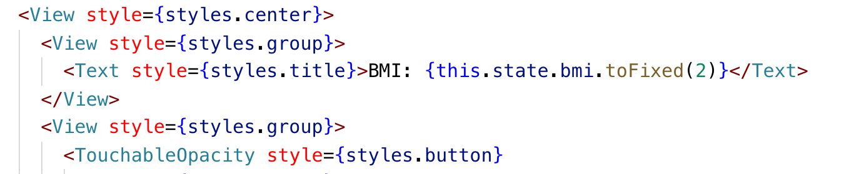
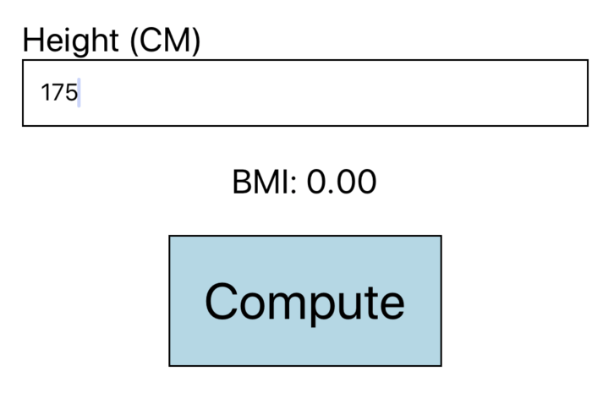
Showing The Output

Slide 27
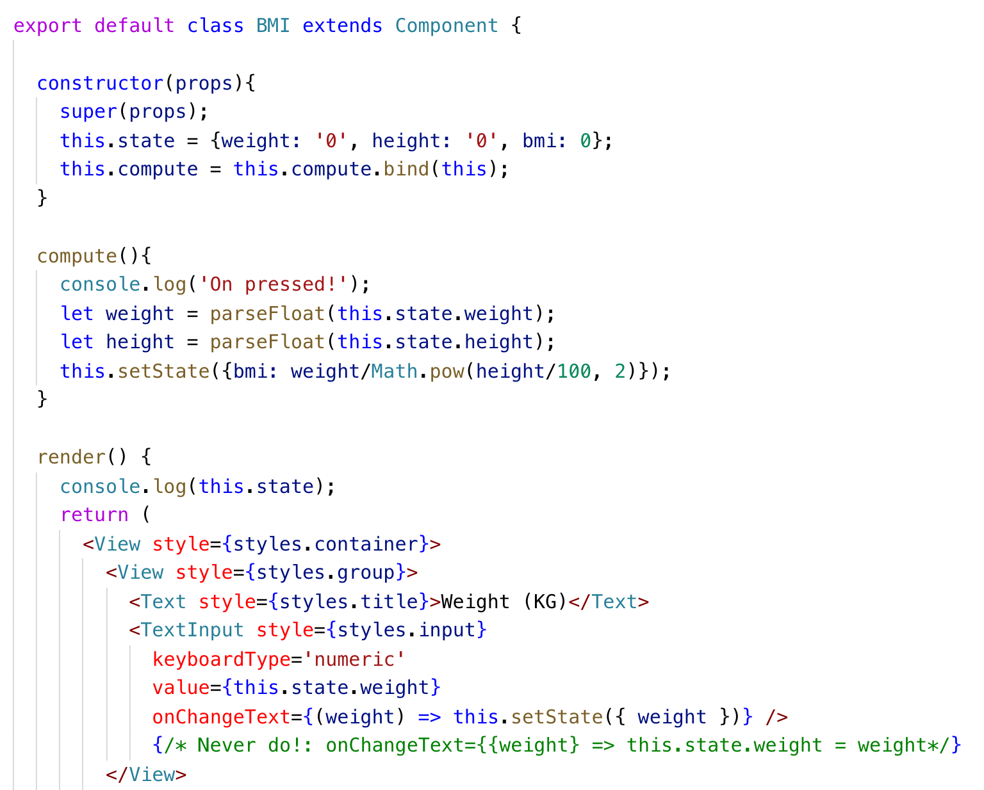
Full Source Code# 1

Slide 28

Full Source Code# 2

Slide 29


Full Source Code# 3

Slide 30


BMI Final

Slide 31
Exercise 1
Showing the obesity level under the BMI number.
BMI > 32 = Obese
25 < BMI < 32 = Over Weight
18.5 < BMI < 25 = Normal Weight
BMI < 18.5 = Under Weight

Slide 32

StopWatch

Slide 33



StopWatch

Slide 34


StopWatch

Slide 35



StopWatch

Slide 36

Initialize State

Slide 37

Showing the TimeElapse

Slide 38


Handle Start Button Pressed

Slide 39

Minutes-Second-MilliSeconds Format
Press Start Button
TimeElapsed in milliseconds is displayed
We need to format TimeElapsed to 00:00.00 format
We have a library for that. Go to terminal at the working directory
>|$ npm install minutes- seconds-milliseconds --save

Slide 40


Minutes-Second-MilliSeconds Format

Slide 41

UI Seperation
We need to make the Stop button first. (Only start is showing now)
It is a good idea to seperate the start/stop button UI from the main render method, since the main render method is very long (hard to read, and hard to maintenance)

Slide 42


Start button
startStopButton method
Using startStopButton method

Slide 43


Bind this to StartStopButton

Slide 44

Making timer stop

Slide 45



Working start/stop timer app

Slide 46
Making lap function works!
Every time when user press the lap button, record the current timeElapsed into this.state.lap and reset the startTime
Make the lower half of the app’s screen showing the list of timeElapsed in this.state.lap array.

Slide 47


Lap button UI seperation

Slide 48

Display the lap array

Slide 49


Display the lap array

Slide 50

See The Difference

Slide 51

Full Source Code #1

Slide 52

Full Source Code #2

Slide 53


Full Source Code 3

Slide 54


Full Source Code #4

Slide 55


Result

Slide 56
Home Work
How to reset the laps?
Scrollable Laps?
It is leaved as the homework for you
See the iOS 10’s stopwatch app for idea

Slide 57


